Slide 1


Customer Churn Prediction
Presented by Alex Hamedaninia

Slide 2

AGENDA
Business Problem
Background
Data Processing
Exploratory Data Analysis
Analysis
Results
Limitations, assumptions, and challenges
Implementation plan
Sources
Notes:
In this presentation we’ll go over the business problem, some background about the issue, how we processed, explored and analyzed the data, and the results. Then we’ll understand the limitations, assumptions, and challenges of the data, and go over an implementation plan.

Slide 3
Business problem
Can we reduce customer churn by predicting which customers are at risk of churning, and predicting what their needs are in order to reduce this risk?
Notes:
This project seeks to answer this question by conducting predictive analysis on customer bank churn data. Through the development of robust predictive models, the objective is to pinpoint customers most susceptible to churning and devise effective strategies to mitigate this risk, thereby enhancing customer retention and reducing overall company cost.

Slide 4
background
Customer churn refers to customers ending their relationship with a company
This includes closing accounts or switching to competitors, resulting in increasing costs for the company.
Mitigating customer churn is crucial.
One effective strategy is customer churn prediction, allowing for companies to identify at-risk customer and implement targeted retention tactics
Churn prediction optimizes resource allocation.
Also improves operational efficiency, sustains current client base, and is essential for success in a competitive financial landscape
Notes:
Customer churn refers to customers ending their relationship with a company, such as closing accounts or switching to competitors, resulting in increased costs for the company.
Mitigating customer churn is crucial, and one effective strategy is customer churn prediction, which allows banks to identify at-risk customers and implement targeted retention tactics.
Predicting churn not only minimizes revenue losses and acquisition costs but also addresses underlying issues, enhances customer satisfaction, and strengthens the company's competitive position.
Overall, churn prediction optimizes resource allocation, improves operational efficiency, and sustains the current client base, essential for success in a competitive financial landscape.
Presenter Notes:
Customer churn is when customers stop using a company's products or services, which can be costly for the company.
To combat this, banks use customer churn prediction to identify customers likely to leave and implement strategies to retain them.
This not only saves money but also improves customer satisfaction and strengthens the bank's competitive position.
Churn prediction is crucial for optimizing resources, improving efficiency, and maintaining a strong client base in a competitive market.

Slide 5
Data preprocessing
Dataset contains 18 variables including geography, gender, age, tenure, credit score, balance, complaints, satisfaction score, and a binary indicator for customer churn
Removed unnecessary variables, including variables to protect customer privacy
Transformed categorical variables into dummy variables
No missing values to deal with.
Notes:
The dataset for this project, sourced from Kaggle, includes 18 variables related to bank customer churn.
To prepare the data for analysis, we removed redundant variables like RowNumber, CustomerID, and Surname for privacy protection.
Categorical variables like Location and Card Type were converted to dummy variables to facilitate numerical analysis.
Thankfully, the dataset didn't contain any missing values, making it ready for exploratory data analysis without further cleaning

Slide 6
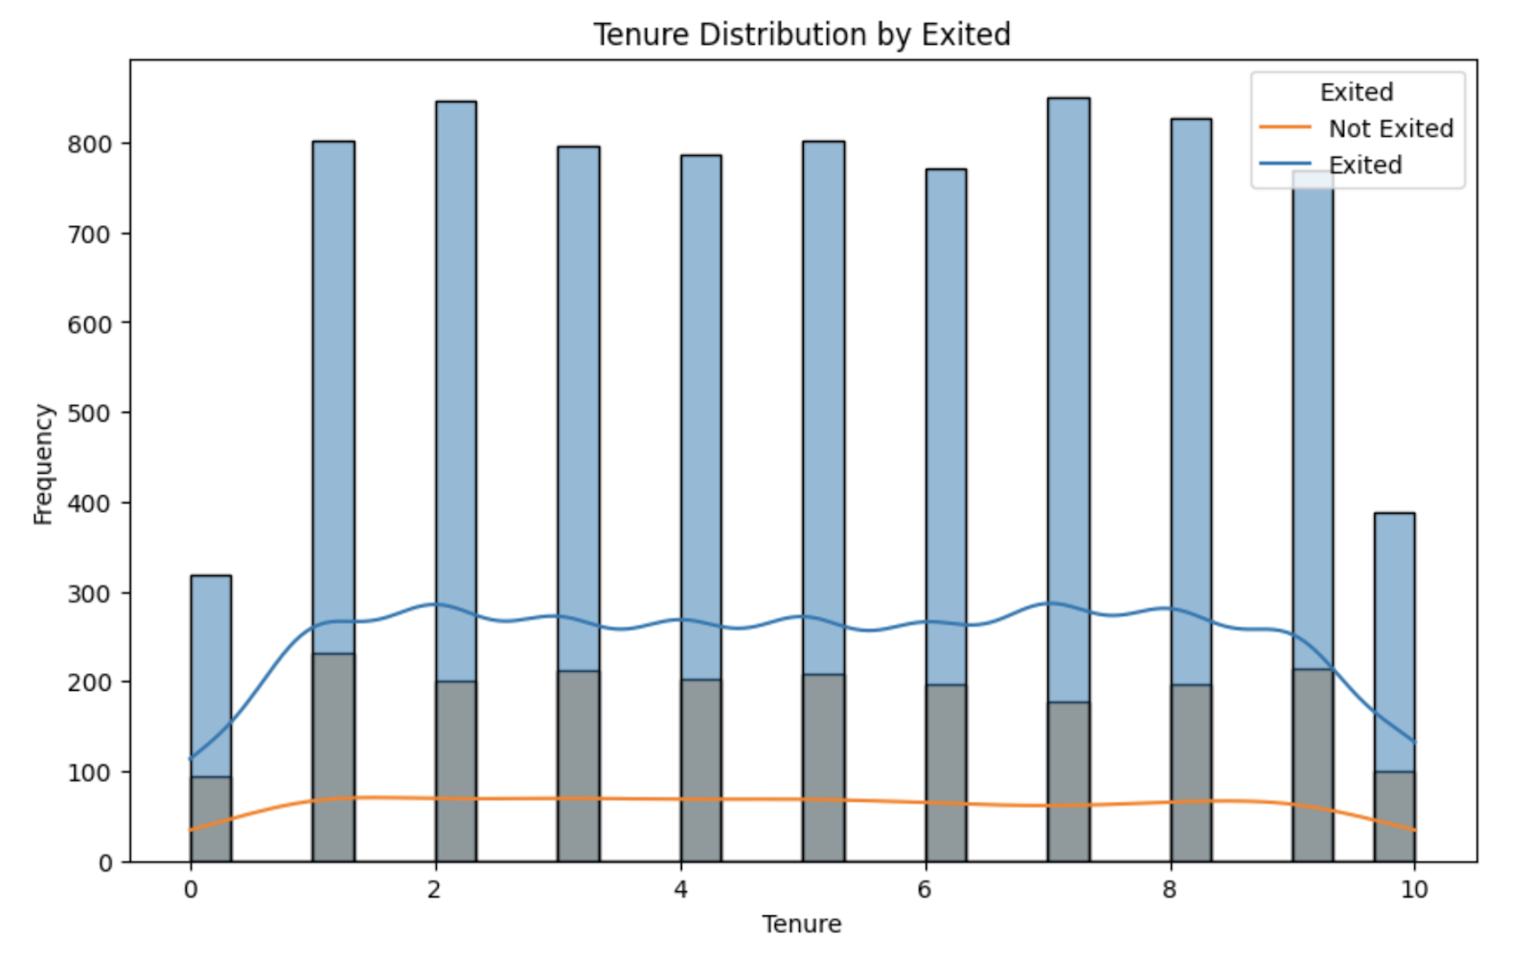
Exploratory data analysis
Distribution of customers who churned is quite evenly distributed from newer to more tenured customers.
Suggests length of time a customer has been with a company does not significantly impact their chances of churning.
Notes:
The first notable aspect of this chart is that the distribution of tenure for customers who churned is quite evenly distributed from new customers to customers who had been with the company for about 10 years. There is a small dip for brand new customers and those who have been with the company for 10 years, but it is quite even throughout. This suggests that the length of time a customer has been with a company does not significantly impact the likelihood of them churning alone.

Slide 7
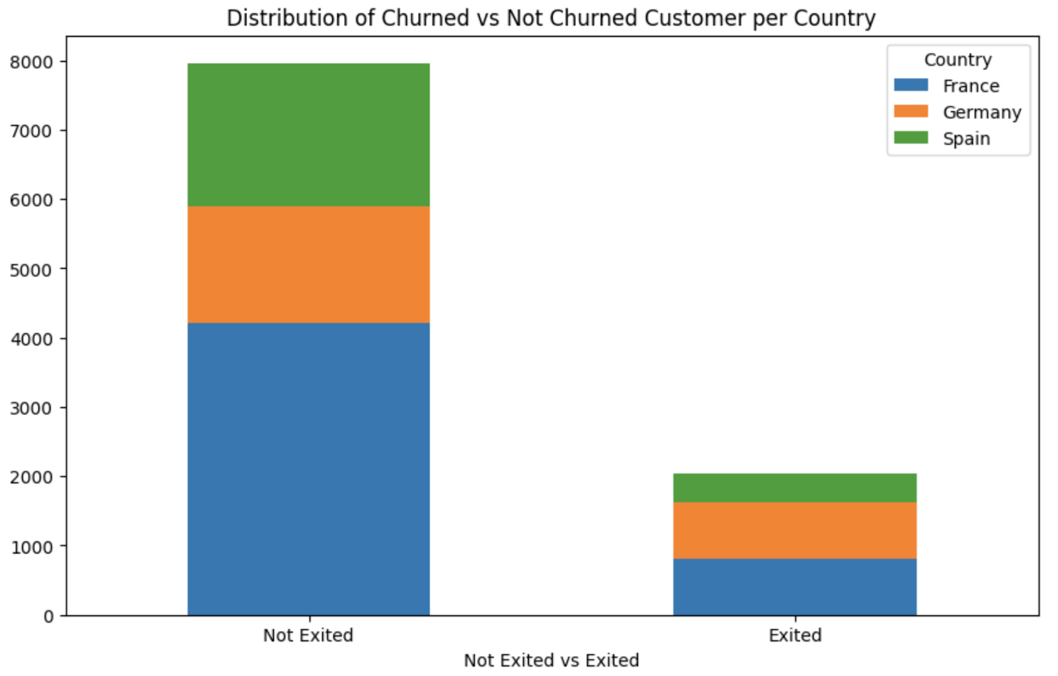
Exploratory data analysis (cont’d)
Amount of customers churning are proportional to the customers not churning for both France and Spain, but not the case for Germany.
The ratio of non-churned to churned customers in France and Spain is 20%.
This ratio is 48% for Germany.
Notes:
Most of the customers are from France, and the amount of customers churning are proportional to the amount not churning for each country, with the exception of Germany. This country appears to be half the size of its original amount. Upon analyzing the churn proportions across different countries, it is evident that the ratio of non-churned to churned customers varies. Specifically, in Germany, this ratio stands at approximately 48%, while in France and Spain, it hovers around 20% each. This indicates that customers from Germany are more likely to churn, which will be important for the analysis later on.

Slide 8
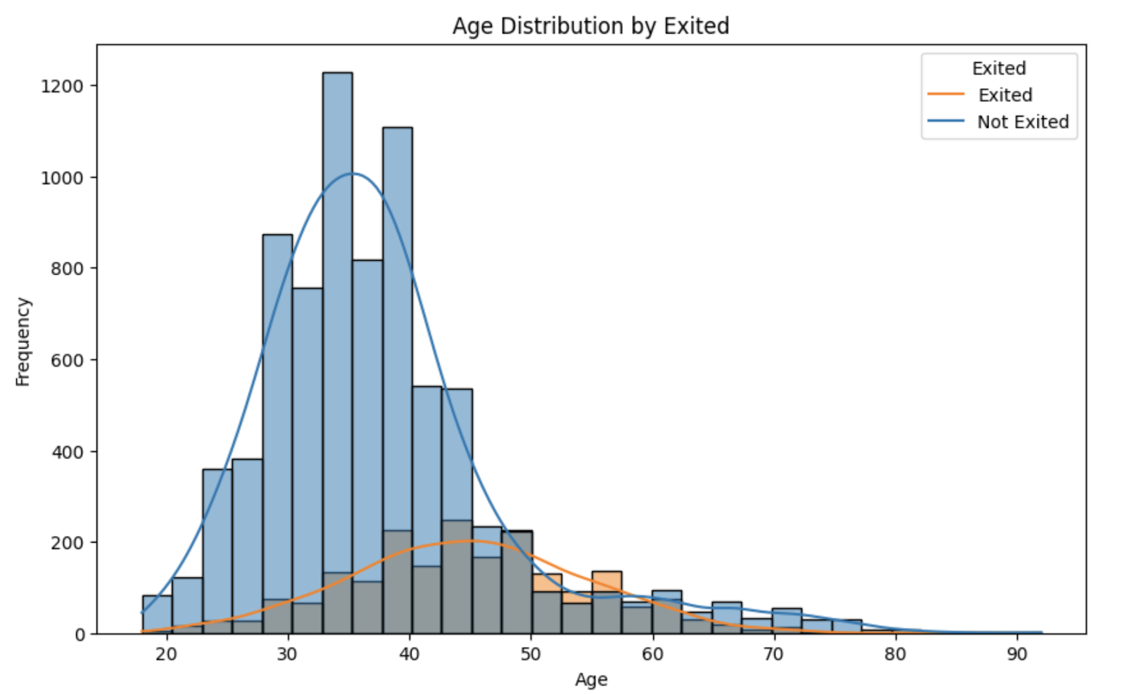
Exploratory data analysis (cont’d)
Younger customers are less likely to churn
Between ages 45-60, customers are at a much higher risk of churning.
Potential cause is retirement age.
Notes:
The next graph here is an age distribution, a stacked bar chart distinguishing those who exited the company or not. In this case, it is apparent to note that those on the younger side seem less likely to leave, but between the ages of 45 to 60, these customers are at a higher risk of churning. This may be due to nearing retirement age and thus a change in finances. Whatever the case may be, this will be important to note for future analyses.

Slide 9
analysis
Data is prepared for modeling, focusing on binary classification using logistic regression
Features are standardized using StandardScaler to enhance model performance
Model’s performance is evaluated on testing data, computing metrics including accuracy, precision ,recall, and F1-score
Results from classification report and confusion matrix offer comprehensive insight into model’s predictive capabilities
Notes:
Data is prepared for modeling, focusing on binary classification using logistic regression.
Initial split separates features and the target variable, Exited.
Further split divides data into training and test sets with a 70/30 ratio for model training and evaluation.
Features are standardized using StandardScaler to enhance model performance.
Logistic regression model is initialized using scikit-learn's LogisticRegression class.
Model's performance is evaluated on testing data, computing metrics including accuracy, precision, recall, and F1-score.
Results from classification report and confusion matrix offer comprehensive insight into the model's predictive capabilities.

Slide 10
results
The model yielded an an impressive accuracy of 99.87%
Classification report highlights precision of 99% and recall of 100% for churned customers and 100% for non-churned customers
Confusion matrix shows minimal misclassifications
Additional data is needed for further analysis.
Notes:
The model achieved an impressive accuracy of 99.87%, showcasing exceptional performance in predicting customer churn.
The classification report highlights high precision, recall, and F1-score values for both churned and non-churned customers, with precision of 99% and recall of 100% for churned customers and 100% for non-churned customers.
The confusion matrix shows minimal misclassifications, reinforcing the model's reliability in predicting customer churn.
With the model's success, the focus shifts to reducing churn. Exploratory data analysis reveals higher churn rates among customers from Germany and those aged 50-60 years, indicating potential areas for improvement.
Additional data, such as reasons for complaints and leaving, are needed to better understand and mitigate these issues, emphasizing the importance of further analysis and data collection.

Slide 11
Limitations, assumptions, and challenges
Data quality and reliability are assumed.
Logistic regression modeling assumes a linear relationship and no multicollinearity present
While data identifies at-risk customers and potential reasons for churn, deeper insights are required.
Interpreting logistic regression coefficients becomes challenging with complex relationships or interactions between variables.
Effective visualization is essential for conveying findings.
Notes:
Data quality and reliability are assumed, impacting the validity of findings; completeness, accuracy, and representativeness of the dataset are assumed.
Logistic regression modeling assumes a linear relationship between variables and minimal multicollinearity.
While the data identifies at-risk customers and potential reasons for churn, deeper insights require additional data, especially regarding customer complaints.
Logistic regression, though suitable, may not capture complex nonlinear relationships; more advanced algorithms may be necessary.
Effective visualization and communication strategies are essential for conveying findings.
Translating insights into actionable churn reduction strategies is hindered by limited understanding of why customers left the company, emphasizing the need for deeper data exploration and trend identification.

Slide 12
Implementation plan
Deploy model into production environments for real-time predictions
Implement automated alerts and noitifications triggered by the model
Notifiy relevant stakeholders to take timely action
Track model performance metrics, customer feedback, and business outcomes to identify areas for improvement
Provide training and educations to staff
Notes:
Deploy the model into production environments like online banking portals, customer service platforms, or marketing automation systems for real-time predictions.
Implement automated alerts and notifications triggered by the churn prediction model to proactively identify at-risk customers.
Notify relevant stakeholders, such as account managers or customer service representatives, to take timely action based on churn predictions.
Track model performance metrics, customer feedback, and business outcomes to identify areas for improvement.
Provide training and education to relevant staff members on using the churn prediction model and retention strategies effectively, ensuring staff understand how to interpret model predictions and take appropriate actions to retain customers.
Following these steps facilitates seamless deployment of the model in the production environment and enables effective interaction with at-risk customers.

Slide 13
Q&a
How was customer churn defined and measured in this project, and what factors were considered in identifying churned customers?
What preprocessing techniques were applied to the dataset to ensure data quality and prepare it for modeling?
What machine learning algorithms were considered for predicting customer churn, and why was logistic regression ultimately chosen as the primary modeling approach?
How was class imbalance addressed in the dataset, and what techniques were employed to ensure reliable predictions for both churned and non-churned customers?
What features were identified as significant predictors of customer churn, and how were they selected or engineered from the original dataset?
Notes:
How was customer churn defined and measured in this project?
Customer churn was defined by the binary indicator variable Exited, which had a 1 if the customer churned, and 0 if they were still with the company.
What preprocessing techniques were applied to the dataset to ensure data quality and prepare it for modeling?
I removed the redundant variable RowNumber, as well as any personal information variables such as CustomerID and Surname. I then converted the categorical variables Location and Card_Type to dummy variables.
What machine learning algorithms were considered for predicting customer churn, and why was logistic regression ultimately chosen as the primary modeling approach?
Random forest modeling was also considered for its feature selection, but ultimately logistic regression was chosen after checking its near perfect accuracy score.
How was class imbalance addressed in the dataset, and what techniques were employed to ensure reliable predictions for both churned and non-churned customers?
The distribution of the data was checked graphically to ensure a mostly normal distribution, ensuring the data was balanced and to ensure reliable predictions for both churned and non-churned customers
5. What features were identified as significant predictors of customer churn, and how were they selected or engineered from the original dataset?
The features identified as significant predictors of churn were chosen through the exploratory data analysis, and were identified through the graphs made.

Slide 14
Q&A
How was the performance of the churn prediction model evaluated, and what metrics were used to assess its effectiveness in predicting churn accurately?
What insights were gained from the exploratory data analysis, particularly regarding regional differences in churn rates and potential drivers of churn among customers from different countries?
What ethical considerations were taken into account throughout the project, and how were privacy, fairness, transparency, and accountability upheld in the collection and use of customer data?
How were the findings and recommendations from the churn prediction project communicated to stakeholders, and what actions were taken based on the model's predictions to reduce customer churn?
What are the limitations and future directions of the churn prediction project, and what steps will be taken to address them and further improve the effectiveness of customer retention strategies in the banking sector?
Notes:
How was the performance of the churn prediction model evaluated, and what metrics were used to assess its effectiveness in predicting churn accurately?
Accuracy score, precision, F1-score, recall, and a confusion matrix were utilized to assess the effectiveness in predicting churn accurately.
What insights were gained from the exploratory data analysis, particularly regarding regional differences in churn rates and potential drivers of churn among customers from different countries?
We were able to determine that customers from Spain and France had a churn rate of approximately 20%, but customers from Germany have a churn rate of 48%. More information is required to understand why this is.
What ethical considerations were taken into account throughout the project, and how were privacy, fairness, transparency, and accountability upheld in the collection and use of customer data?
Customer data protection was taken into account with the removal of customer ID and surnames in the model creation. Additionally, understanding the limitations and assumptions as clearly depicted in the write up are essential for stakeholders to understand.
How were the findings and recommendations from the churn prediction project communicated to stakeholders, and what actions were taken based on the model's predictions to reduce customer churn?
The findings and recommendations are communicated to the stakeholders through this PowerPoint presentation at a later date, and the actions are yet to be determined5. What are the limitations and future directions of the churn prediction project, and what steps will be taken to address them and further improve the effectiveness of customer retention strategies in the banking sector?
In this analysis we were only able to understand so much as to why these customers are churning. More information regarding what the customers complained about and why they decided to leave the company is required, and conducting sentiment analysis using natural language processing to understand where the company can improve to lessen the risk of these customers churning.

Slide 15
Sources
Radheshyam Kollipara. (2022, April). Bank Customer Churn, Version 1. Retrieved April 11, 2024 from https://www.kaggle.com/datasets/radheshyamkollipara/bank-customer-churn/data

